Slide 1

PREDICTION OF ELECTRICITY ACCESS IN AFRICA USING MACHINE LEARNING
Presented by Mugide Gloria

Slide 2
PROBLEM STATEMENT
A report from the African Development Bank Group indicates that over 640 million Africans lack access to electricity. Moreover the IEA points out that electricity access is one of the pillars of economic growth, poverty eradication and social justice. However, power is an immense issue of financial, technological, political, environmental and scientific concern hence there are complicated impediments that curtail its acceptance.
This project aims to develop a machine learning model to analyze historical electricity access data and predict future access levels in African countries, helping to identify trends, disparities, and areas requiring urgent intervention. This will help the governments to have proper planning for infrastructural development.

Slide 3
DATA DESCRIPTION
The data contains 22905 rows and 17 columns. These columns include:
SeriesCode, SeriesName, Indicator: Identifiers and descriptions related to the electricity access metric.
SeriesID, GeoAreaCode/Reference Area Code: Numerical identifiers for the series and geographical area.
Ref_Area_Type, GeoAreaName/Reference Area Name: Categorical information about the type of reference area (e.g., Regional, Country) and the name of the geographical area (e.g., country names, regional commissions).
TimePeriod: The year of the data collection.
Value: The proportion of population with access to electricity (this column was initially of object dtype acontained non-numeric values like '..', 'NA', which were later handled).
Units: The unit of measurement for Value, typically 'PERCENT'.
Nature, Location: Additional categorical features, with Location indicating 'ALLAREA', 'RURAL', or 'URBAN'.
Reporting Type, FootNote, Source, ISOalpha3, Type: Other descriptive and metadata columns.
while most columns were complete, Ref_Area_Type, Value, Nature, Reporting Type, FootNote, and ISOalpha3 had missing values.
Data source; world bank

Slide 4
DATA MANIPULATION
Removing columns with less than 80% of the data missing (22905, 14)
Dropping all the rows without data (22316, 14)
Performed data slicing to remain with only african countries (3635, 14)
Rectifying any issues with the data type of value to numeric

Slide 5
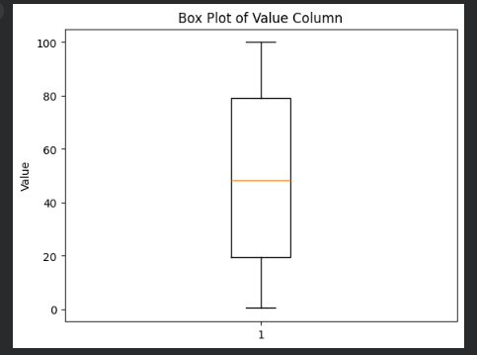
EXPLORATORY DATA ANALYSIS
BOX PLOT

Slide 6
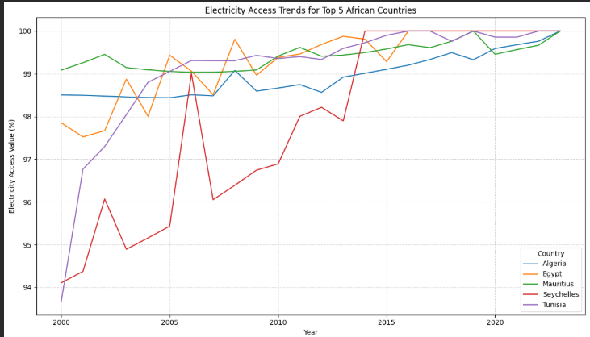
CONTINUED EDA……
LINE PLOT

Slide 7
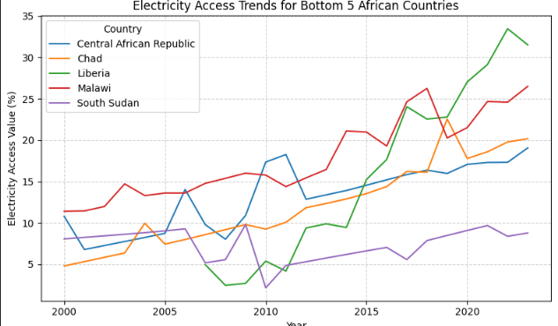
EDA CONTINUED….
LINE PLOT

Slide 8
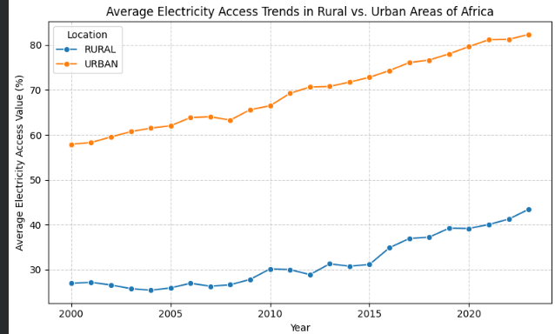
EDA CONTINUED….
LINE PLOT

Slide 9
MODELS
Linear Regression;
Linear Regression is the baseline for most predictive modeling. It assumes a linear relationship between the input variables (x) and the target variable (y).
How it works: It finds the "Line of Best Fit" by calculating weights (coefficients) for each input. The goal is to minimize the Sum of Squared Residuals (the distance between the actual data points and the line).
Random Forest
Random Forest is an "ensemble" method, meaning it combines the predictions of many individual models to get a more accurate result.
How it works: It builds dozens or hundreds of Decision Trees on different subsets of the data. For a regression task, each tree produces a numerical prediction, and the model takes the average of all those predictions.
Strengths: It is excellent at capturing non-linear relationships and handles outliers much better than linear models. It also reduces the risk of "overfitting" (memorizing the data) because it relies on the consensus of many trees.

Slide 10
MODELS CONTINUED……
3. Neural Network
Neural Networks are inspired by the human brain and are part of the "Deep Learning" family.
How it works: They consist of layers of "neurons." Each neuron takes an input, applies a weight and a nonlinear function (like ReLU), and passes it to the next layer.
The Learning Process: Through a process called Backpropagation, the network adjusts its internal weights to minimize the error between its prediction and the actual value.

Slide 11
MODEL EVALUATION
metric | Random forest | Neural Network | Linear Regression
Mean absolute error | 2,41 | 11.28 | 9.13
Mean squared error | 14.18 | 212,45 | 140.89
Root Mean squared error | 3.77 | 14.58 | 11.87
R-squared | 0.99 | 0.86 | 0.79

Slide 12
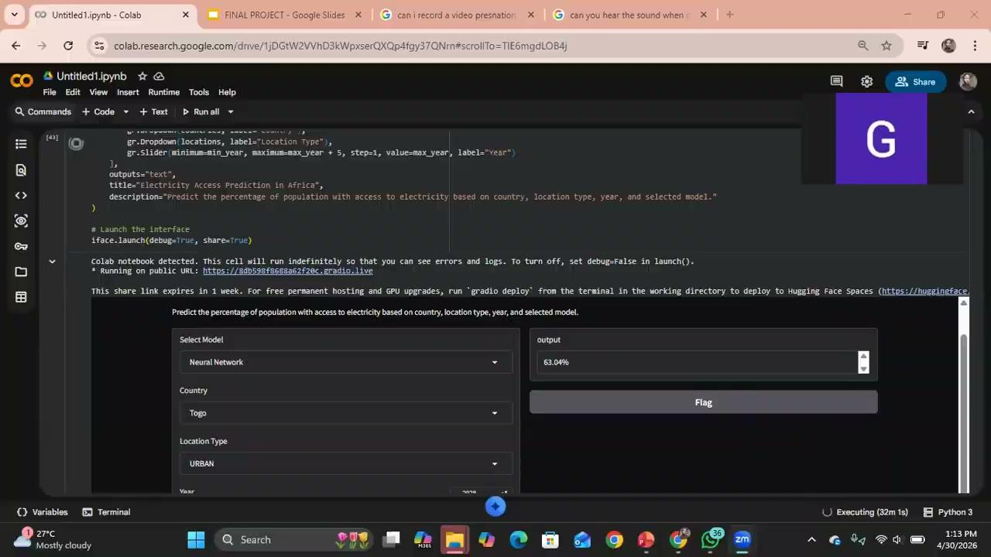
DEMO VIDEO
video;

